Slide 1



Move & Modernize Legacy Apps
Modernize your apps on Oracle Cloud
Alexandre Fagundes
LAD Partner Enablement
January 2023

Slide 2
Move Apps to OCI
Move Apps
Oracle Apps
EBS, JDE, PSFT
Custom Apps
Oracle Tech-based Apps
Other Custom/Legacy Apps
ISV Apps
Move packaged ISV Apps
Notes:
This slide shows all the possible ”Move Apps to OCI” scenarios. The focus of this deck is Moving Custom Apps. Move Oracle Apps (EBS, PSFT, JDE) and Move ISV Apps are 2 other motions and those are covered in separate decks.

Slide 3

Outline
Why Move Legacy Applications to the Cloud?
What Custom Applications are a Good Fit?
What Cloud Infrastructure Capabilities Matter Most?
How Can I Ensure Financial and Performance Benefits?
What Blueprints Can I Follow to Ensure Success?

Slide 4
Why Move Custom Applications to the Cloud?
General
Custom/Legacy App Specific
Increase agility/flexibility and automation
Improve performance and scalability
Move to OPEX and pay for only what you use
Reduce overall costs
Improve security and availability
SaaS is the future
Modernize older applications
Better support frequent application changes
Better integration to new or existing services
Hosting provider problems
Hardware infrastructure is aging
High admin costs
Notes:
Actually, the question these days is not so much about why move applications to the cloud but what is driving companies to move more and more of their workloads to the cloud?
From what I have found working with customers, Security, data modernization, and lower cost are among the top drivers for cloud migration but it goes beyond that. Let’s look at the tactical and operational reasons why companies are moving their applications to the cloud.
Companies across industries are looking at ways to improve their operational efficiency and cloud gives them a path to do that. Increased agility, automation, a clear path to modernization, better security and scalability are the main operational benefits why customers are moving to the cloud. And in terms of the custom applications, moving to the cloud solves some of the tactical pain points. Among other things, moving custom apps to cloud allows you to reduce the administration costs, modernize applications, move to a DevOps model, and retire their aging infrastructure.

Slide 5
Three Cloud Strategies for Migration/Modernization
Move
Improve
Modernize or New
Move application “As Is” / Update infrastructure
Upgrade software / increase automation
Shift to New Technology or Add Functionality
Move complete VMs to the cloud
(e.g., KVM, VMware)
Consolidate compute, storage, databases
Use Flex infrastructure
Improve by updating architecture to add performance, security, add automation, leverage managed services,
Autonomous DB, upgrade software
Move and rewrite to containerize with Docker and Kubernetes, run on Oracle Container Engine, App Dev in the cloud, add new functionality like mobile, ML
Rehost
Replatform
Refactor
Notes:
Discuss 3 Rs as migration choices.
Elaborate on each choice
Highlight how OCI is better suited for Rehosting apps than other providers like AWS because of its differentiated architecture, guaranteed SLAs.
Map those 3 Rs to Move, Improve, and Modernize/New
Let’s first look at the business needs that are driving the migration and modernization choices. When it comes to moving apps to the cloud, I often see customers using 3 different strategies when they consider migrating applications to the cloud.
Rehosting — Otherwise known as “lift-and-shift.” or move as-is
Replatforming — I sometimes call this “lift-tinker-and-shift.”
Refactoring / Re-architecting — Re-imagining how the application is architected and developed, typically using cloud-native features.
The strategy that customers pick depends and is different for each application. Factors like complexity of app, criticality of app, time it takes to move the apps, and business value of moving the app to cloud are some of the key points that they look at to decide the strategy.
Customers can pick any or even take a hybrid approach of moving some part of the stack, improving some other part and rearchitecting too. For example, moving an app as without changing the software stack or versions is the least risky path and is often taken when customers are looking to exit the data center because of outdated hardware, lack of space and scalability constraints. The second improve option is usually involves slightly updating the existing architecture by leveraging managed platform services. For example, if you an Apache Tomcat application with MySQL DB as the backend, you should probably evaluate leveraging MySQL Cloud service on Oracle Cloud instead of manually setting up and managing the database in the cloud. This will get you improvements using the automation included with MySQL cloud service like automated backups, patching etc. And finally, you could completely rewrite your existing application and make it cloud native. This approach does require the largest investment in terms of time and resources initially to set it up but gives you all the benefits of distributed computing like scale, agility and lower costs.
And with Oracle Cloud we offer a path for customer to chose either of these options. They can move their apps as is using our second generation Oracle Cloud Infrastructure services. Or leverage our platform services in combination with infrastructure services to move and improve applications. And if you want to refactor and build net new apps you can go completely cloud native with containers and Kubernetes.

Slide 6
Types of Legacy Apps to consider moving to OCI
Leveraging Managed services, unique infrastructure and automation
Oracle-Based Custom Apps
Other Third-party Apps
App Tier: WebLogic (Java EE)
DB: Oracle DB, MySQL, JSON DB
Apps: Java, PHP, Python, Go, NodeJS
DB: Any DB (Oracle or Non-Oracle)
DB Managed services
Improved Productivity
Java custodian
WebLogic - OCI VM or OKE
Price Performance
BYOL/UCM choice
Price performance
Support for OSS, BYOS
Open Source
Lower cost
No Vendor lock-in
OCI benefits
Notes:
The next question is which applications should I move to the cloud? As I mentioned earlier, Oracle Cloud is designed for all the 3 situations - moving your applications as-is, moving and improving them and also redesigning them as new cloud native apps. This slide shows two broad categories of applications and databases that can be easily moved to Oracle Cloud. Oracle technology based custom apps and all other custom apps.
Other Custom Apps:
If you have Custom or 3rd party apps in Java, Node.js, Ruby, PHP, Python and more, those can be moved easily as well. These could be Java Application servers such as Tomcat, JBoss, and these can be easily moved to Oracle Cloud as well. Almost all apps have a database associated whether its a SQL DB or a NoSQL DB. Oracle offers managed services for both SQL And noSQL databases. In addition to the managed services, you can install any of the other databases like SQL Server, MongoDB or Cassandra.
Oracle Cloud Infrastructure delivers higher performance compute, storage, networking, and managed database instances that result in a high-performance experience for your users at a lower cost of operation.

Slide 7

What Cloud Infrastructure Capabilities Matter Most?

Slide 8
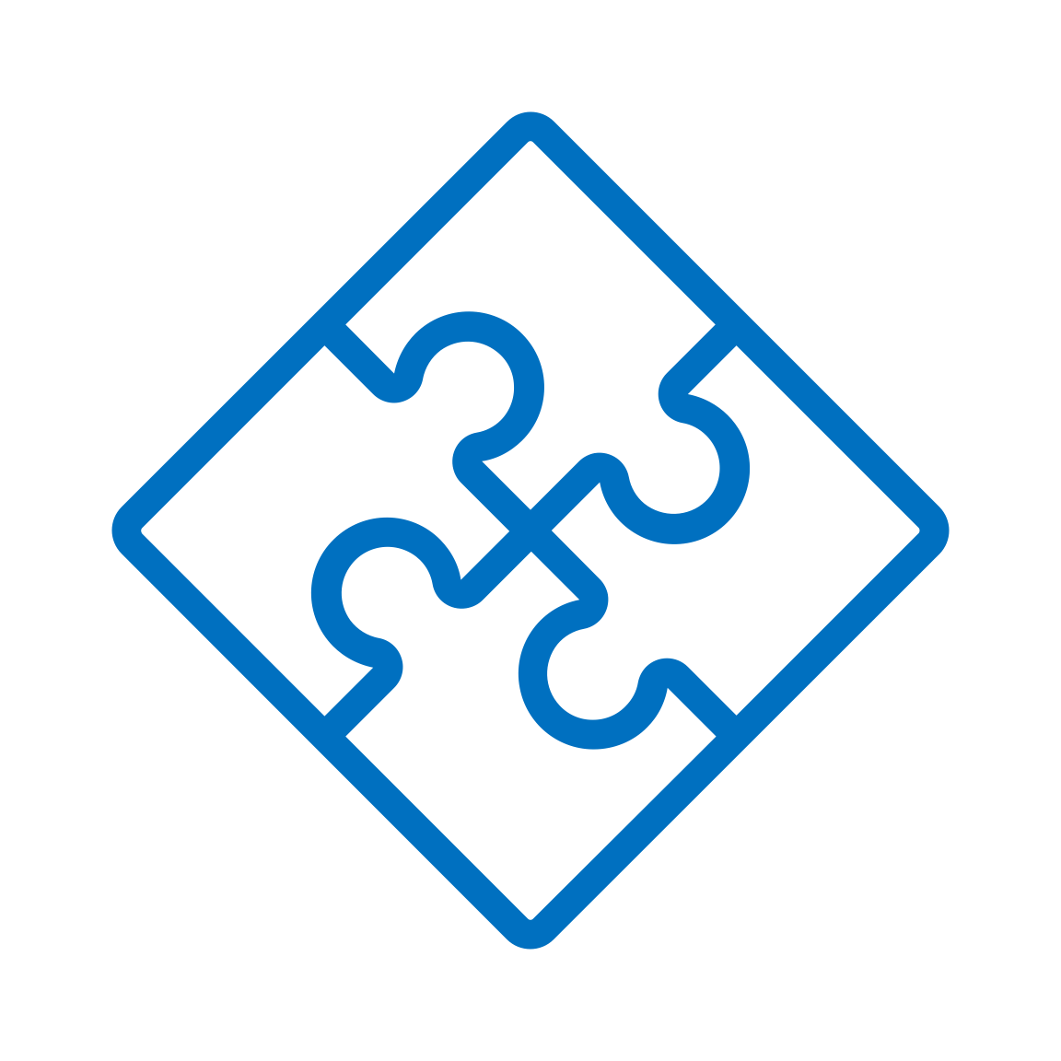
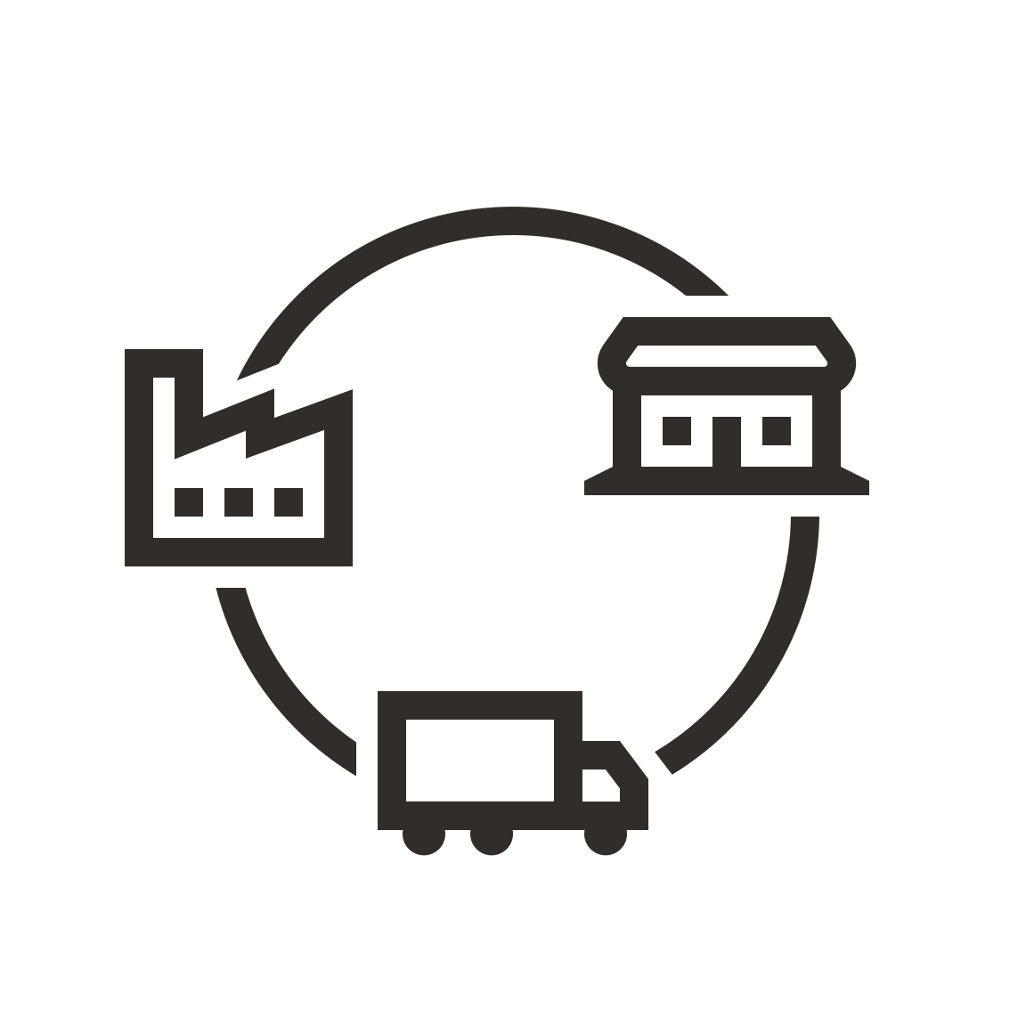



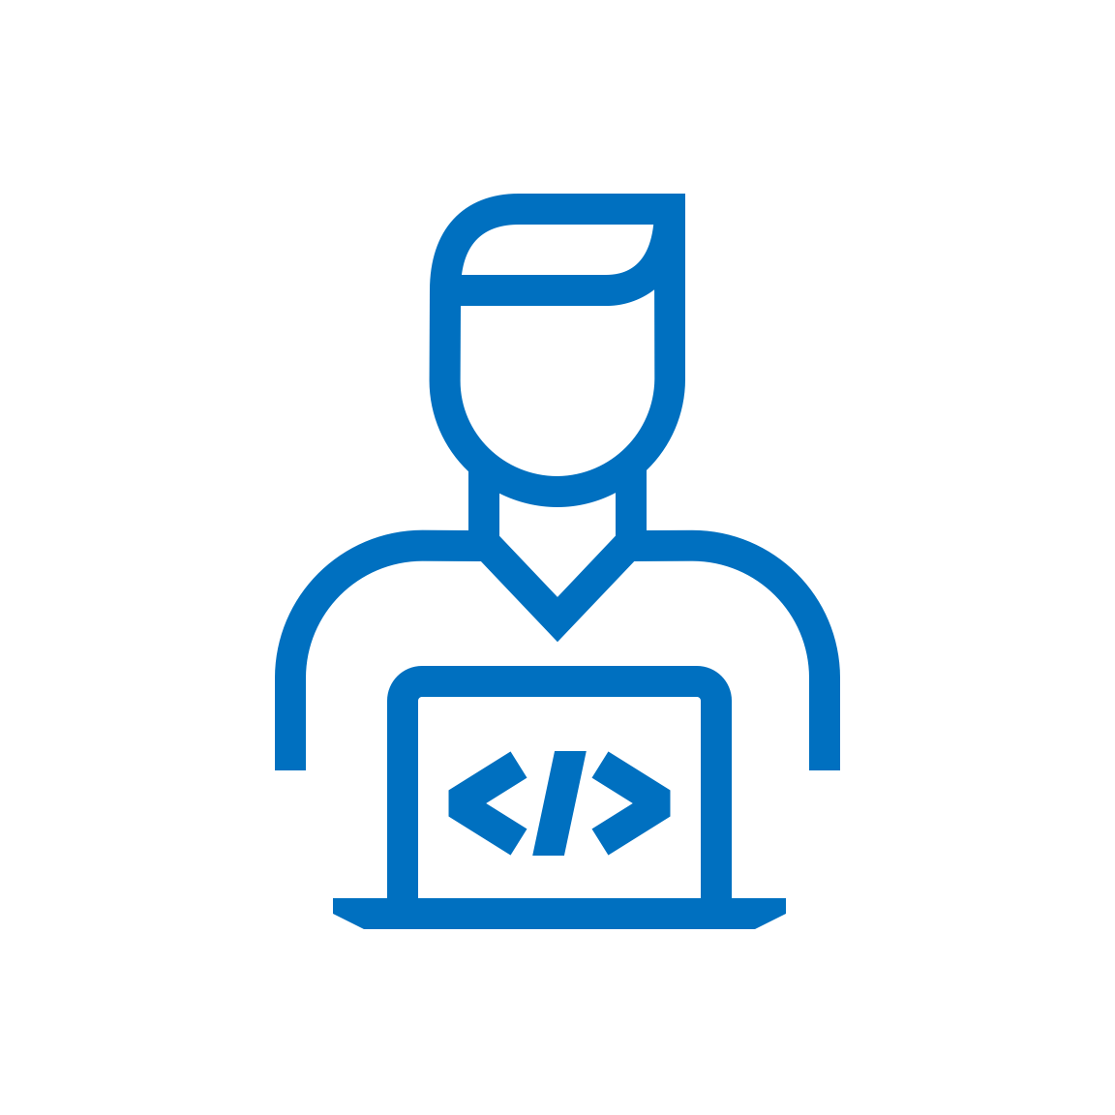
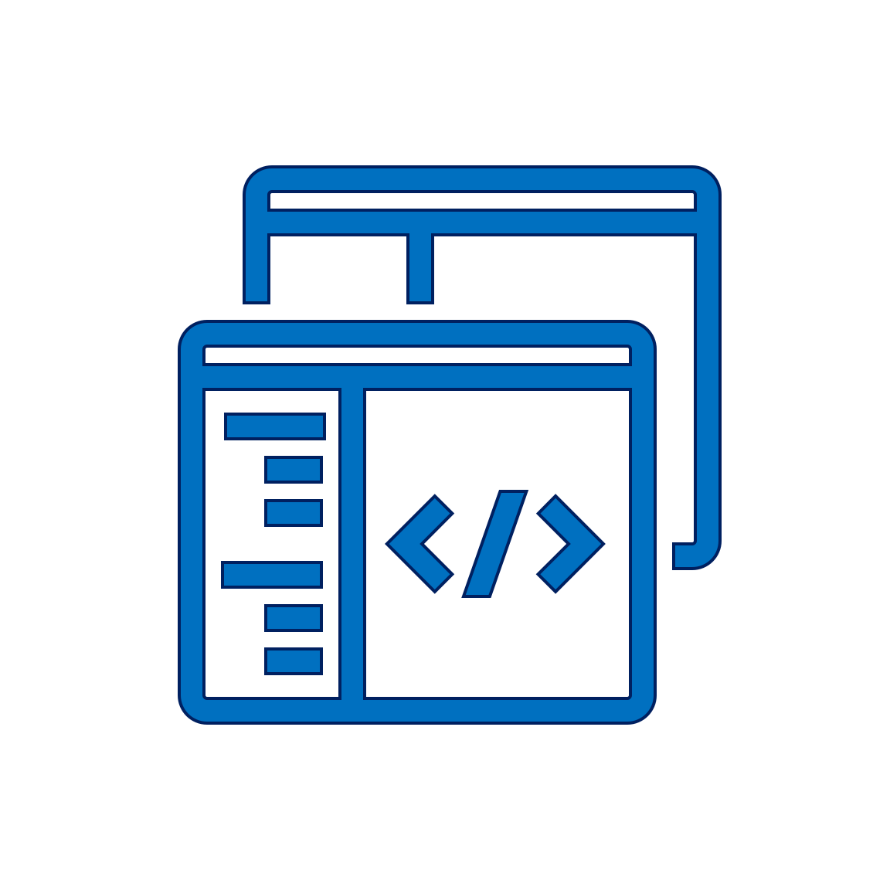
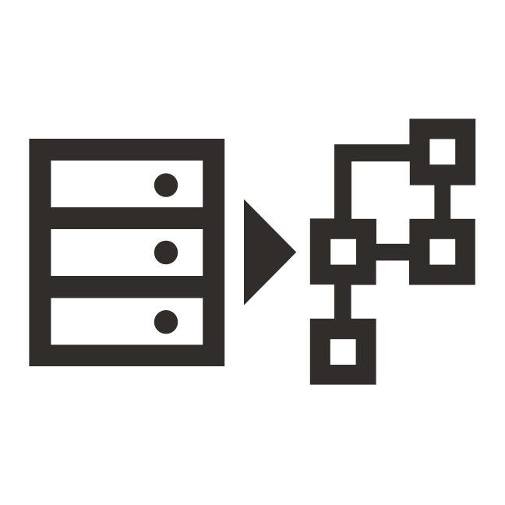
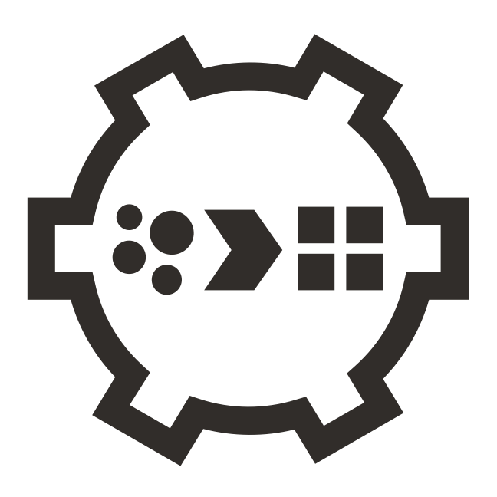
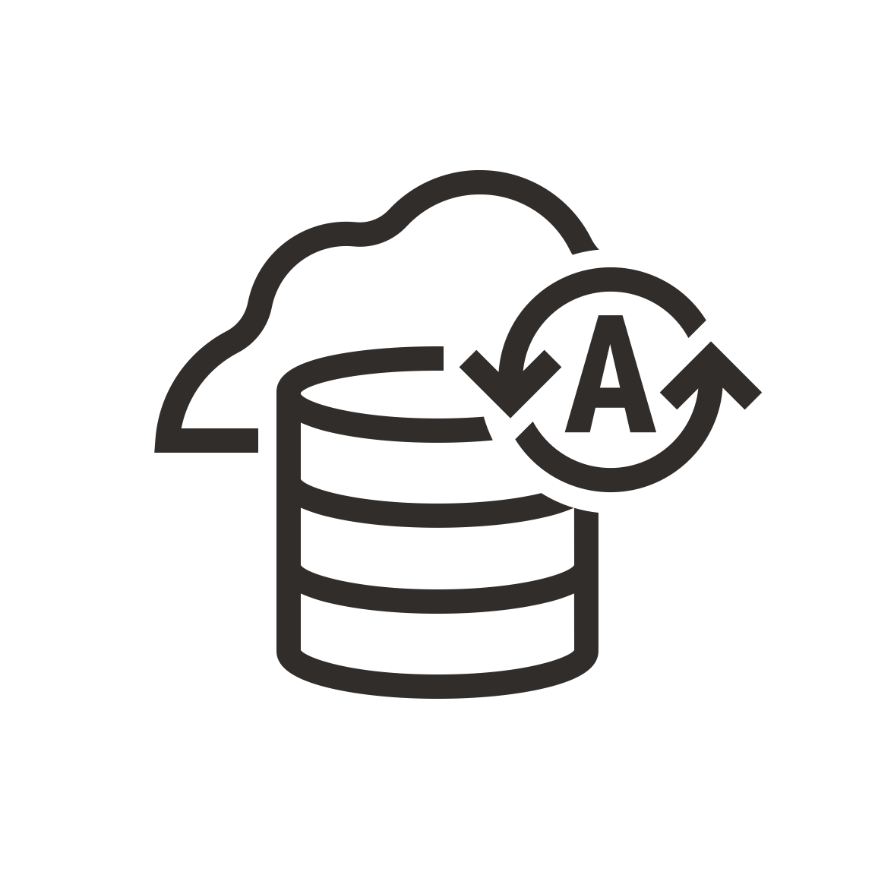







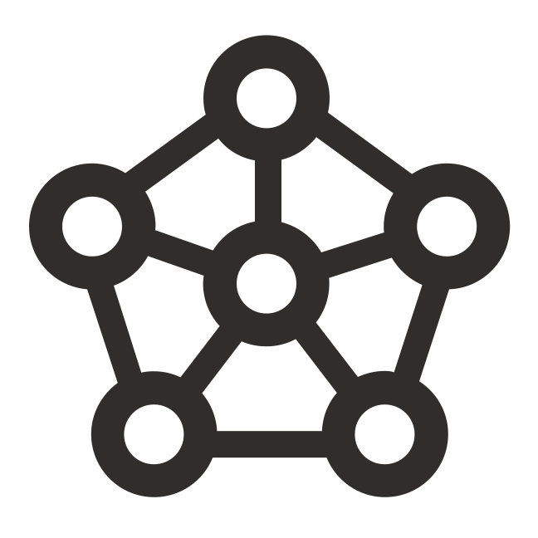

Oracle Cloud - Comprehensive Services for Dev and Deploy
APPLICATION DEVELOPMENT & DEVOPS
APPLICATIONS
ANALYTICS
GOVERNANCE & SECURITY
Serverless
Events, Functions, API Gateway, Streaming
Application Integration
Business & Industry SaaS
ERP, HCM, SCM, Sales, Marketing, Service, Vertical Industry
Business Analytics
Analytics, Fusion Analytics
Governance
IAM, Compartments, Tagging, Cost Advisor
Low Code
APEX, Digital Assistant
DATA MANAGEMENT
Data Management
Database Migration, Data Integration, Data Catalog, Golden Gate
Data Lake
Data Flow, Big Data, Data Science, Cloud SQL
Autonomous & Oracle Databases
Transactions, Data Warehouse, JSON, Dedicated, Exadata
Distributed & Open SOURCE DATABASES
NoSQL, MySQL
Security
Cloud Guard, Security Zones, Vault, KMS, Data Safe, DDoS, WAF
AppDev
Visual Builder Studio, GraalVM, Helidon, SQL Developer, Shell, APIs/SDKs
INFRASTRUCTURE
Infrastructure as Code
Resource Manager, Terraform, Ansible
Compute Bare metal, VM, CPUs, GPUs, HPC
Containers
Containers, Kubernetes, Registry
OS, VMware
Autonomous Linux, OS Mgmt Service, Marketplace
Storage
NVMe, Block, File, Object, Archive, Data Transfer
Networking
VCN, LB, Service Gateway, FC, VPN, Cluster Networking
Observability
Monitoring, Logging, Logging Analytics, Notifications, Events
COMMERCIAL REGIONS / GOV REGIONS / CLOUD@CUSTOMER / MULTICLOUD / EDGE
Implementation, Consulting, and Educational Services + Support
8
Notes:
The completeness of cloud services is also very important. While multi-cloud is definitely an option, it’s a path that requires careful planning and app and data integration to work seamlessly, Oracle has a complete set of cloud services for not only moving your existing applications but also building new applications whether they are vM based or container based. All the cloud services are available globally in our commercial as well as government regions. Not only do we have a second generation cloud infrastructure but all the platform services for Application Development, Data Management, Application and Data Integration, Analytics and Security and Governance services. On top of this infrastructure and platform services, Oracle has the SaaS applications. So we offer all 3 layers - Infrastructure, platform and SaaS applications all integrated together.

Slide 9
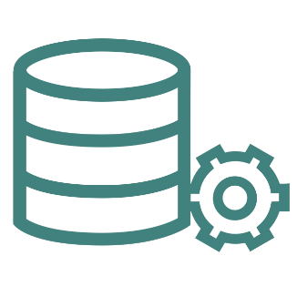
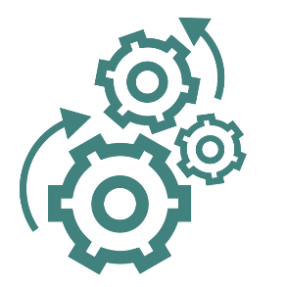



OCI - designed for both Cloud Native & VM based Applications
Leveraging unique infrastructure and tooling
Virtual Machines
Flexible CPU and Memory
Bare Metal instances
Max Performance & consolidation
RDMA Networking
Performance, availability, and manageability SLAs
Autonomous Database & Linux
Infrastructure as a Code
Managed Platform Services
Oracle Integration Cloud
SaaS to on-premises
Prebuilt adapters & recipes
SOA – BYOL and UCM
Public Cloud
Bare metal, container engine, Database services
Government Cloud
US and UK
Cloud @ Customer
Exadata & PCA Cloud @ Customer
Dedicated Region
OCI – Azure Interconnect
Oracle Database Service for Azure
Visibility across cloud and on-prem
Open and interoperable
ML-based rapid troubleshooting
Predictive and preventative analytics
Real-user experience monitoring
+
High-Performance Flexible Infrastructure
Automation & Integration
Cloud, Hybrid Deployment Choices
Improved Observability
Notes:
All Cloud providers are not equal. There are several cloud provider capabilities that matter when selecting a cloud provider to migrate your apps. I will call out a few here. A high-performance Infrastructure with flexible and highly elastic infrastructure and platform is a very important factor. When you move an application, you want to be able to right size the environment to optimize your operational expenses. Over or under provisioning is often a cause of higher operational costs. Flexible infrastructure helps address this.
Oracle Cloud Infrastructure was designed specifically to support both cloud native and VM based enterprise workloads Oracle Cloud Infrastructure delivers higher performance compute, storage, networking, and managed database instances that result in a high-performance experience for your users at a lower cost of operation.
Oracle also provides specific tooling and automation to streamline deployment, migration, upgrading, and maintaining your implementation, reducing the time, expertise, risk, and cost of migration and day-to-day operations.
Closing physical data centers helps fund modern SaaS investments, but what about the on-premises applications that are needed to run the business?
Only Oracle offers the ability to move your Oracle apps with Oracle SOA on Oracle Cloud Infrastructure as-is. This means your existing IT investments are protected. Deploy SOA Adapter for interoperability between Oracle Integration Cloud and Oracle SOA to leverage your existing services.
For more details on Oracle Integration please visit https://salescentral.oracle.com/SCPortal/?root=offeringDetails%2F6115
What we are seeing is not all workloads move to public cloud. There are workloads that remain on-premises or in local country and some that move to public cloud. This could be driven like I earlier mentioned because of latency needs or compliance and data residency needs. Oracle is the only cloud provider that offers all its cloud services in the public cloud as well as in its Cloud@Customer offering via Dedicated Region C@C and Exadata CC. Dedicated Region C@C is literally a copy and paste of all our second generation public cloud services in your data center. And for customers with strict data residency and regulatory needs we also offer Exacta C@C for keeping your data in your data center.
Oracle’s Cloud Observability and Management Platform provides a set of new OCI services that will provide comprehensive monitoring and management for Hyperion from a unified dashboard.

Slide 10
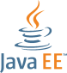
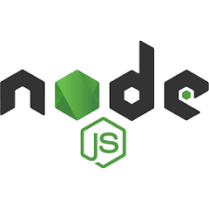
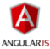
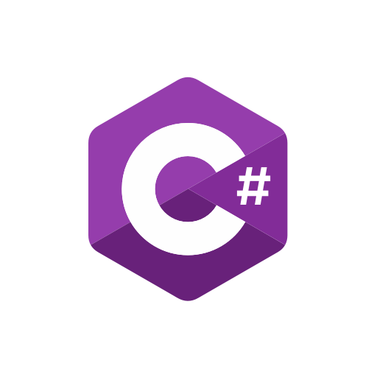



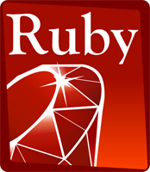
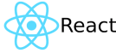
Move and Modernize Development using DevOps on OCI
Any Language, Any Framework
Software Development Lifecycle
Code
Build
Deploy
Test
Secure
Monitor
10
Notes:
Key points:
Once you move your applications, that is not the end of the journey. After moving apps, you will probably want to looking into DevOps automation for building and deploying your custom apps.
OCI offers a fantastic array of application development lifecycle services for developers building modern applications. You have the choice of any programming language and framework: Java, JavaScript/Node, Python, Ruby, etc You can use any developer and DevOps tools as well. We provide a set of free tools called Visual Builder Studio, but you can also use the ones you are already familiar with. We also offer low-code platforms, such as APEX, to make it very simple for developers and “citizen developers” to create apps with little or no programming.
We offer a set cloud native services based on the best of open source, including managed Kubernetes and a Container Registry. We provide managed Terraform, which we call Resource Manager, and we provide a serverless Functions service based on the open source Fn Project.
Here’s what a typical application development lifecycle looks like. You have a choice - you can either use our services or bring in any of the developer tools that you are already familiar with. You have everything that you need starting from coding your applications, building and deploying them using CI/CD, test automation hooks, security tools and then managing and monitoring your custom apps once they are deployed.

Slide 11
Ensuring Financial and Performance Benefits

Slide 12
OCI MySQL Database Service costs less
Annual cost for a 100 OCPUs, 1TB Storage configuration
MySQL Database Service: Standard E3 AMD 16GB/Core, all regions have the same price.
Amazon RDS: Intel R5 16GB/Core, AWS US East.
Azure: Memory Optimized Intel 20GB/Core, MS Azure US-East.
Google: High Memory N1 Standard Intel 13GB/Core, GCP Northern Virginia.
Configuration: 100 OCPUs, 1 TB Storage.
Copyright © 2023, Oracle and/or its affiliates. All rights reserved
Notes:
Pricing URLs
https://www.oracle.com/cloud/price-list.html#mysql
https://aws.amazon.com/rds/mysql/pricing/
https://azure.microsoft.com/en-us/pricing/details/mysql/
https://cloud.google.com/sql/pricing#2nd-gen-pricing https://mariadb.com/products/skysql/pricing/

Slide 13
Move Custom 3rd-Party Apps and Oracle Database
OCI is 51% less than On-Premises, and 71% less than AWS
*Oracle Custom Apps TCO Model
Notes:
Assumptions:
- 2 Environments
- OnPrem: App Server on 8 Cores
- OnPrem: Oracle DB EE + Options on 8 Cores
- OCI: App Server on 8 Cores
- OCI: Oracle DBCS VM EE PayGo on 8 Cores
- AWS: App Servers on 8 Cores
- AWS: Oracle DB EE + Options BYOL on 8 Cores
- 0.5TB App Storage
- 30TB DB Storage + Backup

Slide 14

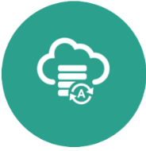
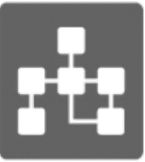
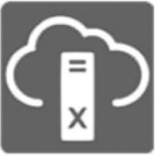
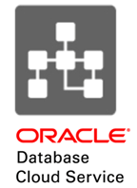
The future is here in Oracle Cloud
But… how to best get there?
Apps & Databases in Oracle Cloud
Autonomous
Database
Database
Cloud Service
Exadata
Cloud Service
Migration concerns
Missing Skillset
Downtime
Converged Database
Data Loss
Auto-Repair
Fast Time to Market
Complexity
Cost
Self-Tuning
Cost Savings
Latency
Scalability
Incompatibility
Self-Securing
High Availability

Slide 15



Complete your migration with peace of mind
Maximize TCO & minimize risk with these business benefits – only from OCI
Flexible Licensing & Infrastructure
Strong SLAs & No Re-Architecture
Cloud Lift + Consulting Services
Cloud Lift Services
Dedicated resources to migrate workloads at no cost
Support from planning to go-live
Oracle and non-Oracle workloads
Included with your Cloud Agreement to accelerate onboarding and success
Support
Oracle Linux and Java support included on OCI
Bring Your Own License
BYOL from on-prem to OCI
Flexible Infrastructure
Right size your VMs for CPU/Memory
Flexible Load balancing
Universal Credits
Commit to an annual amount that can be applied to IaaS and PaaS services
Predictability of spend
No Re-Architecture
Application and data move as-is
Keep customizations integrations
No retraining require
Fastest path to cloud
Availability, Performance, & Manageability SLAs
With high-availability compute, block volume, object storage, and FastConnect services
The first cloud vendor to guarantee performance
Notes:
So you may wonder, “…What does migrating to OCI mean for licensing, what are the support implications?” Rest assured – when you move your Oracle technology based custom apps from on-prem to Oracle Cloud Infrastructure, it’s the same suite you know today. Your customizations, integrations, and licensing– all of these investments move with you.
We recognize that a truly comprehensive cloud solution includes infrastructure, software, processes, and people. With the Cloud Lift Services program – included in your cloud agreement – Oracle is investing alongside our customers to get you up and running on Oracle Cloud faster with eligible workload migrations delivered by our top engineering talent.
Finally, Oracle is the only major cloud provider to back its cloud offering with service-level agreements (SLAs) for performance, availability, and manageability. Oracle guarantees that its cloud resources are available for mission-critical enterprise applications as well as for processor-intensive workloads such as engineering simulations, financial modeling, AI, and machine learning (ML).
Cloud Lift Services provide new and existing customers expanded access to cloud engineering tools and resources to quickly migrate workloads at no additional cost.
https://www.oracle.com/cloud/cloud-lift/

Slide 16

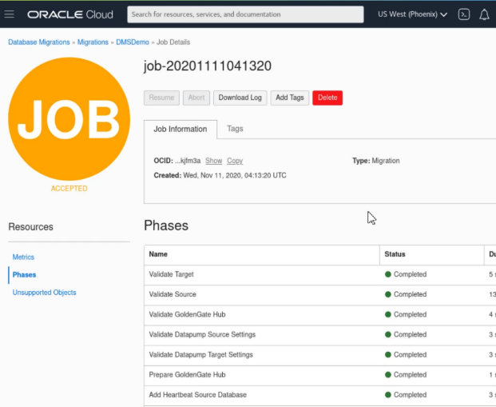
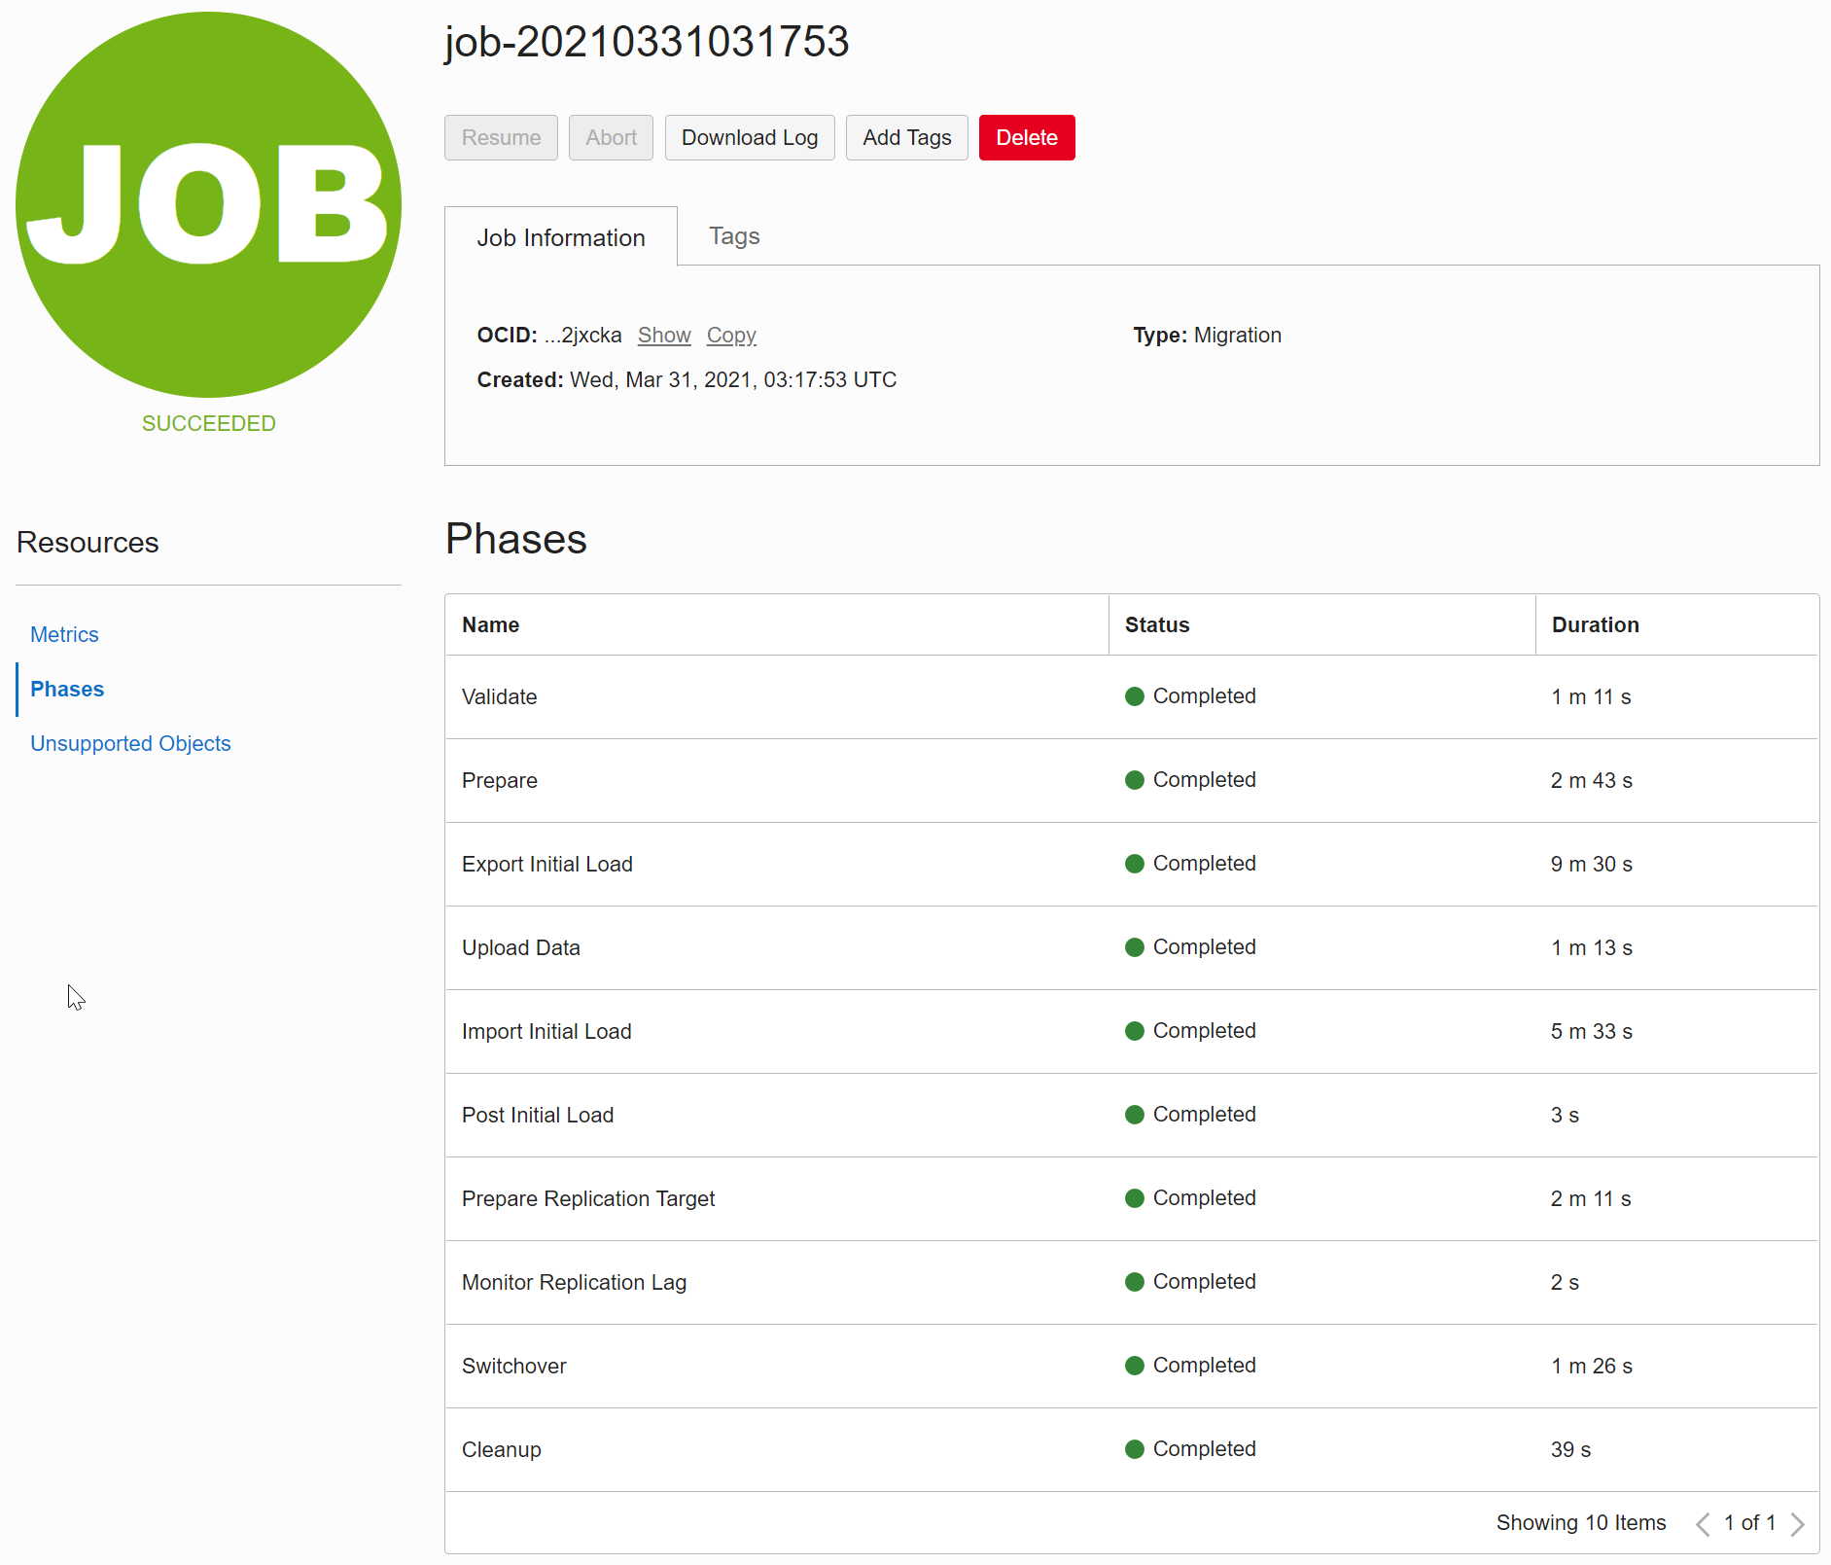
Oracle Cloud Infrastructure – Database Migration
Fully managed, easy to use database migrations into Oracle Cloud
Database Migrations
Reduce cost and improve performance in Oracle Cloud
Migrate databases, free for 6 months per migration
Core Use Cases
Machine-assisted migrations for Oracle Databases, Data Marts and Data Warehouses into Oracle Cloud
Differentiated Use Cases
Simplifies underlying technologies and resources
Logical Offline and Online Migrations
Schema/Metadata Migration
Based on enterprise-strength Oracle tools Zero Downtime Migration, GoldenGate, and Data Pump
UI-led
Experience
Move to
Autonomous
OCI Database
Migration
Based on
Zero Downtime
Migration
Expert Use
Based on
Flexible
Fleet-level
Database Tools: Data Pump, GoldenGate, etc

Slide 17

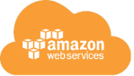
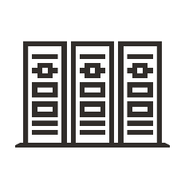


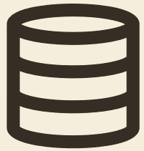
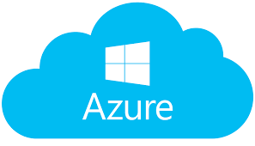

OCI Database Migration - Use Cases
All Source Locations
Migrate On-Premises to OCI Cloud
Migrate Third-party Cloud to OCI Cloud
Migrate Oracle legacy cloud to OCI Cloud
Migrate Within OCI Cloud
With or Without Direct Connection
Offline Migration from behind firewall using Agent
Offline Migration using FastConnect/VPN connection
Online Migration using FastConnect/VPN connection

Slide 18
What Blueprints Can I Follow to Ensure Success?
18

Slide 19
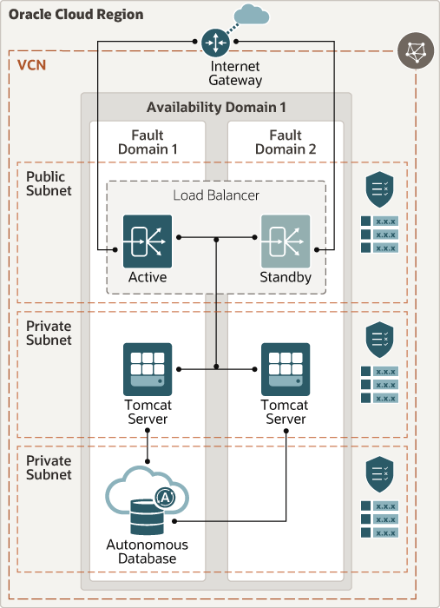
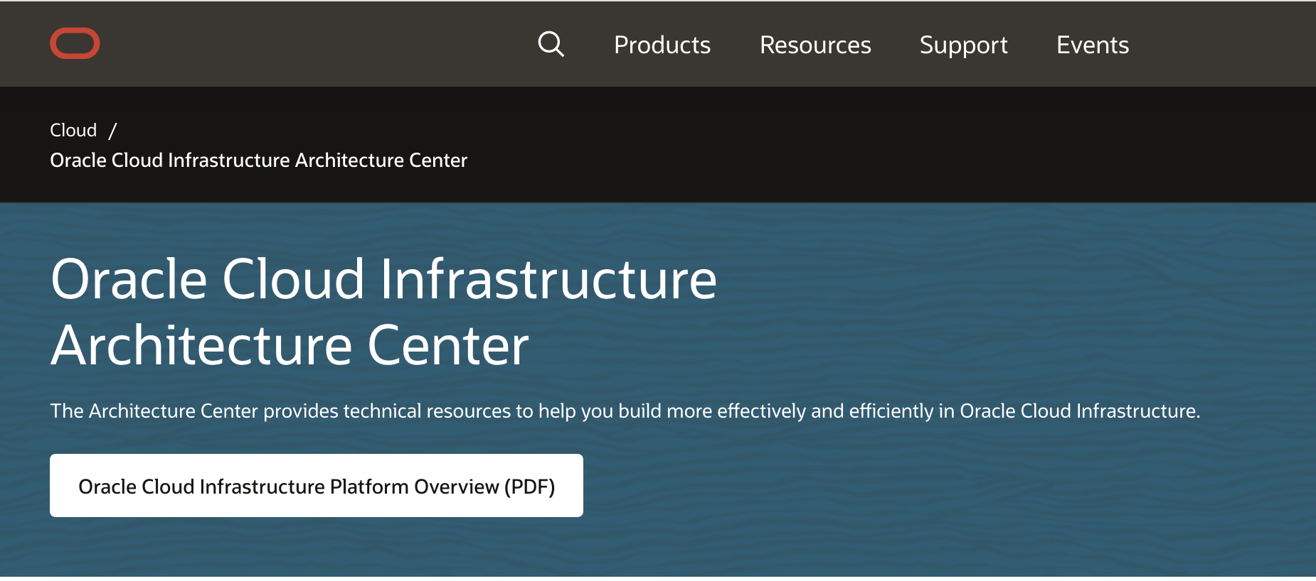
Oracle Reference Architectures
https://www.oracle.com/cloud/architecture-center.html
19
Notes:
The Oracle Architecture Center provides reference architectures and diagrams, solution playbooks. vetted architecture solutions, best practices frameworks, quick start guides, learning paths, and more. Design and implement your cloud, hybrid, and on-premises workloads using our catalog of cross-product reference architectures, solution playbooks, and best practices.

Slide 20
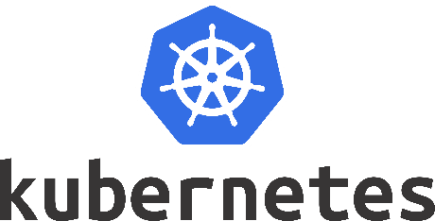
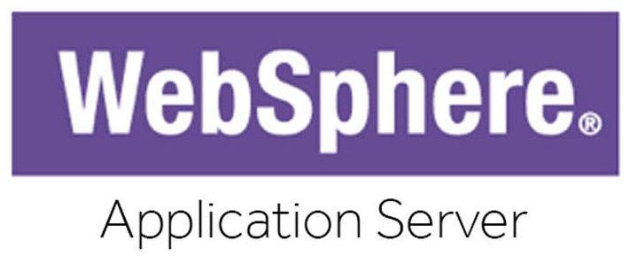
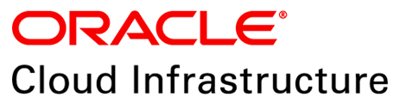
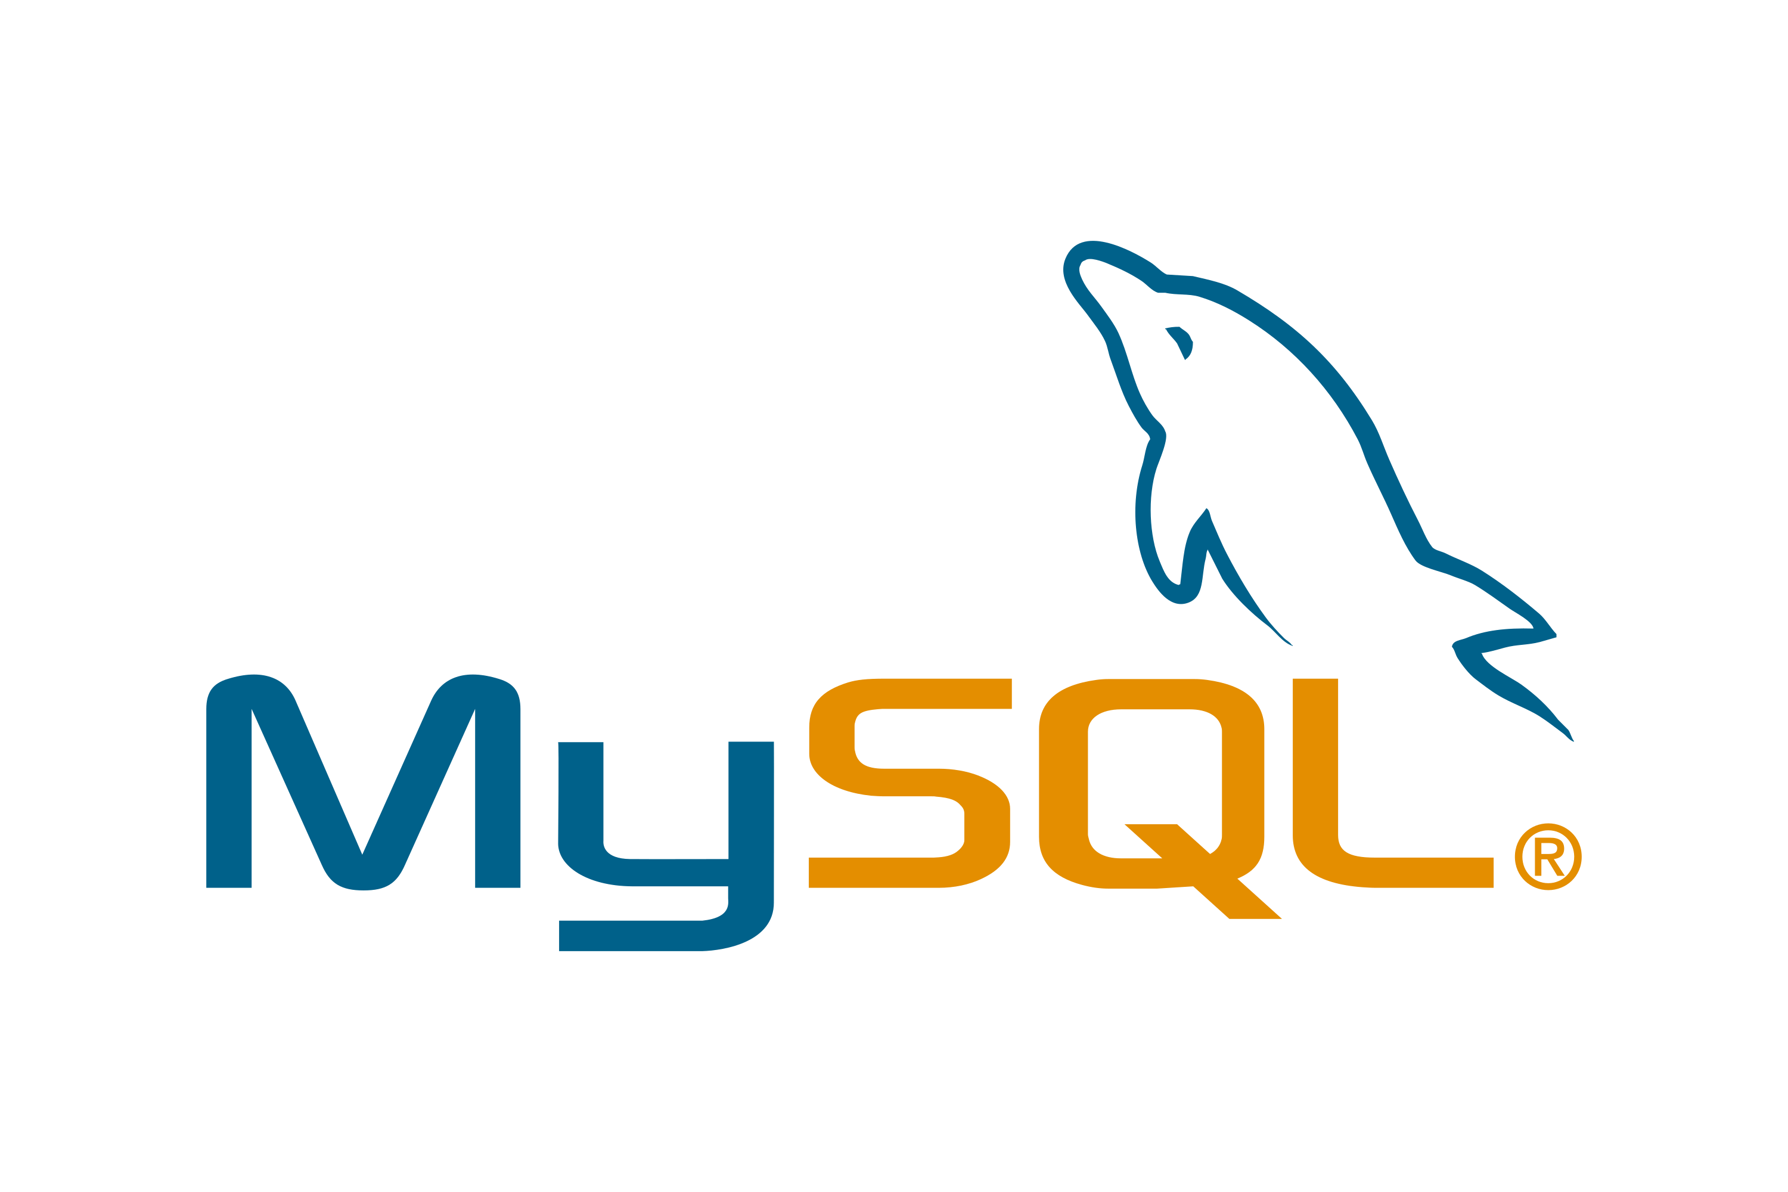
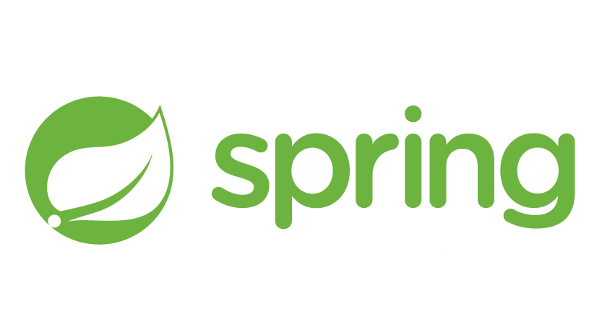


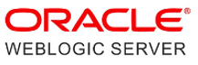
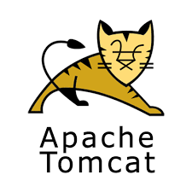
Custom Apps Reference Architecture Examples
+
+
Microservices
+
+
+
+
+
20

Slide 21
Move Custom Applications Resources
Next Steps
Try the Oracle Cloud Free Tier
Watch this Move Custom Overview Video
Try a Move Custom Application lab
Resources
Oracle Cloud Infrastructure Documentation
Migrating Custom Applications Docs
Reference Architectures
Oracle Database Cloud Migration Solutions
Videos:
Migrating from Amazon RDS to Oracle MySQL Database Service
Migrate MySQL from On Premise to MySQL Database Service
Running Drupal with Oracle MySQL Database Service

Slide 22
Thank You
Alexandre Fagundes
LAD Partner Enablement

